Slide 1
Building a Recommendation System with DataStax Enterprise Graph
Artem Chebotko, Ph.D.

Slide 2
Agenda
Recommendation System Basics
DSE Graph and Recommendations
Overview of the KillrVideo Graph
Similarity Measures in Gremlin
Demo of Recommender Traversals

Slide 3
Recommendation System
Recommendation
System
Users
Database
Predictive
Model
Recommendation
Service
Notes:
The purpose is to predict and present items that a user may be interest in
Example of predictive analytics and information filtering

Slide 4
Recommendation System
Recommendation
System
Users
Database
Predictive
Model
Recommendation
Service
Notes:
The purpose is to predict and present items that a user may be interest in
Example of predictive analytics and information filtering

Slide 5
Recommendation System
Recommendation
System
Users
Database
Predictive
Model
Recommendation
Service
Notes:
The purpose is to predict and present items that a user may be interest in
Example of predictive analytics and information filtering

Slide 6
Recommendation System
Recommendation
System
Users
Database
Predictive
Model
Recommendation
Service
?
Notes:
Predictions may not be always accurate
Recall and precision

Slide 7
Predictive Modeling
Content-Based Filtering Approach
Find items with similar features
Recommend items similar to those the user already likes
Collaborative Filtering Approach
Find users with similar interests
Recommend items that users with similar tastes like
Hybrid Approach

Slide 8
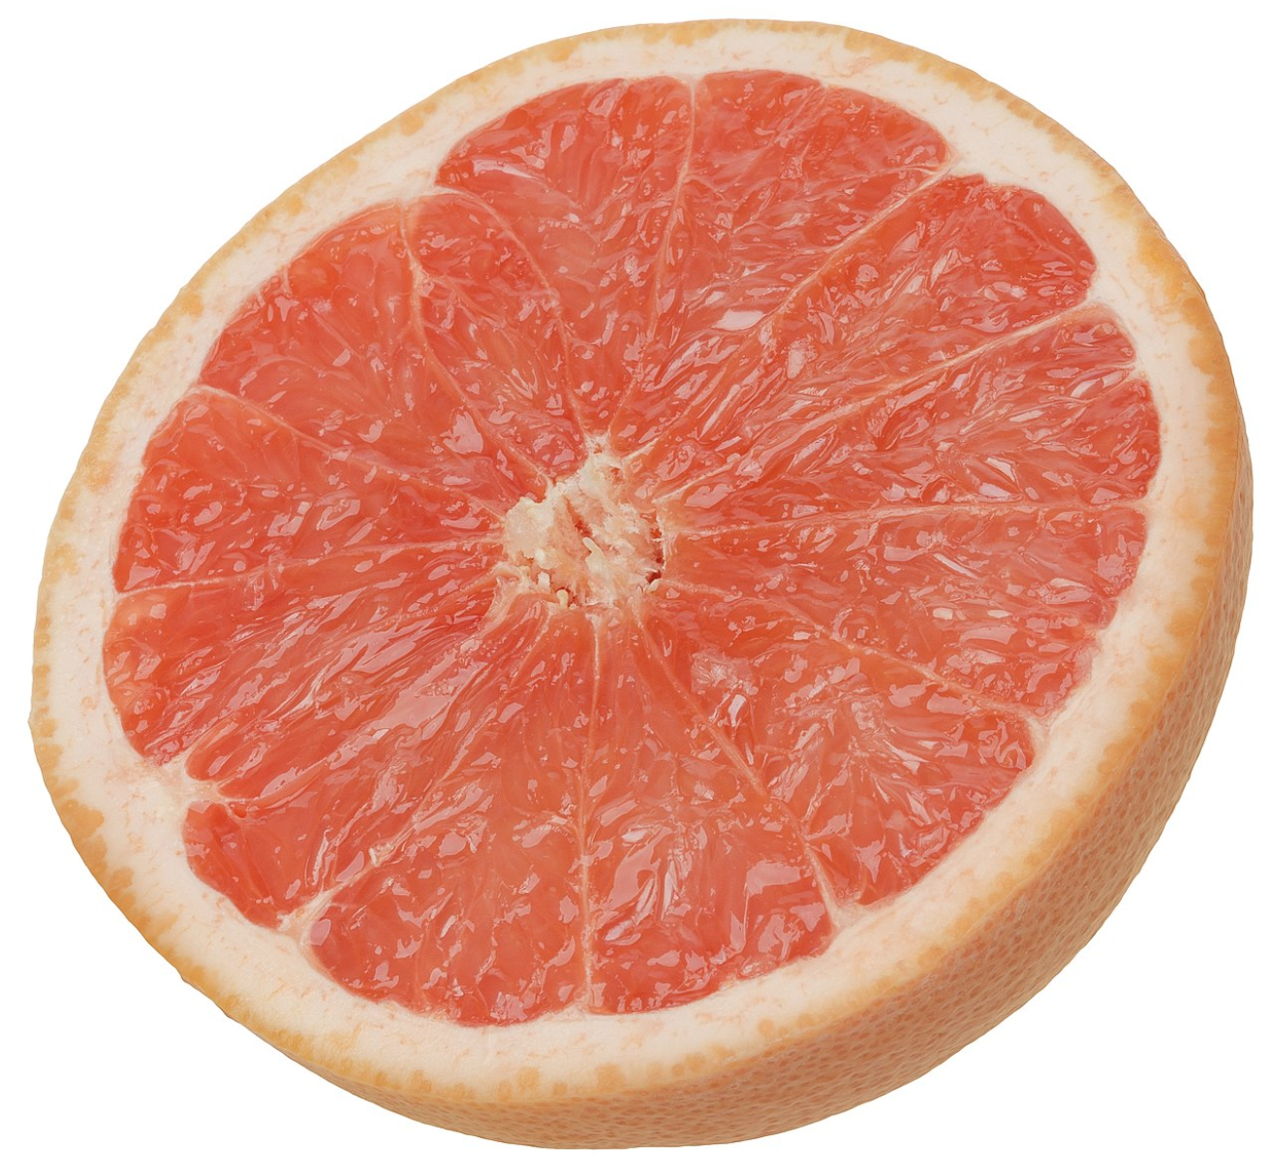
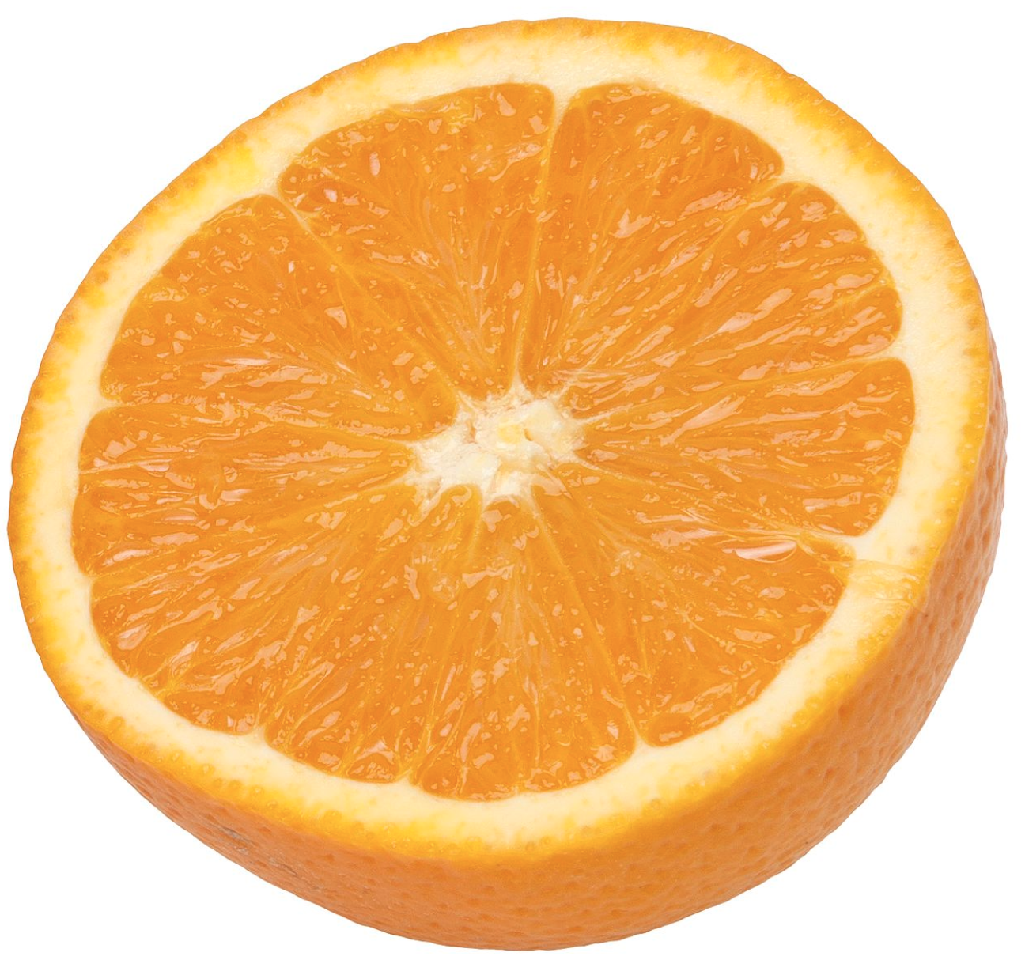
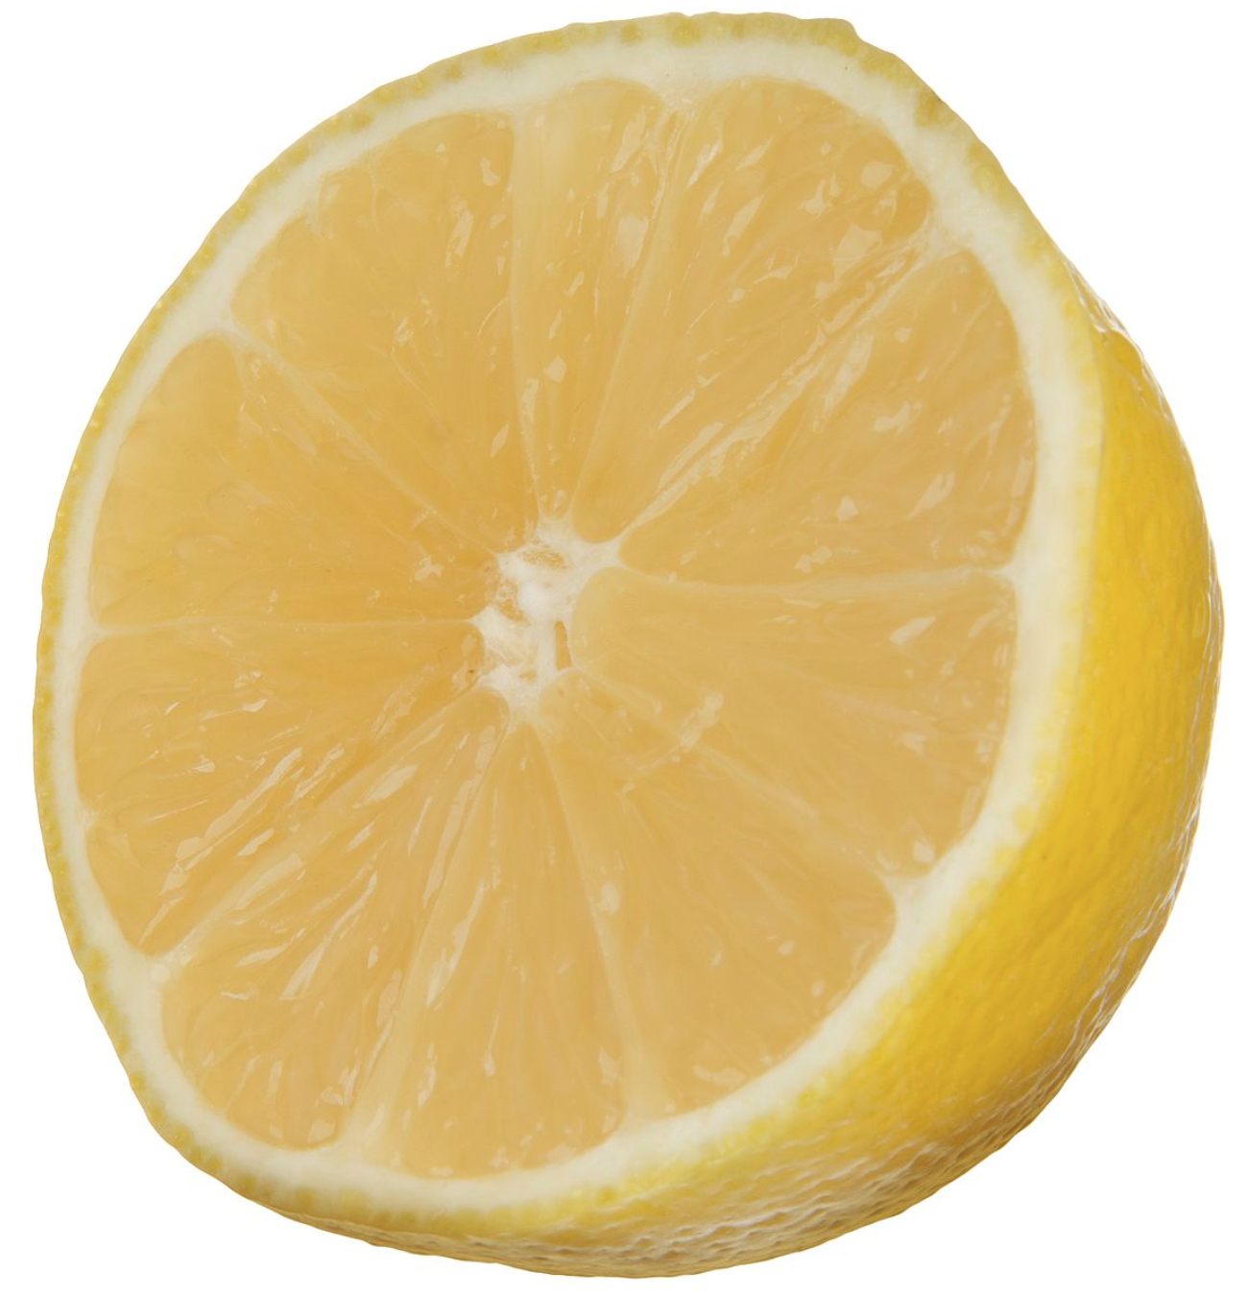
Content-Based Filtering
recommend
similar
likes
recommend
similar

Slide 9
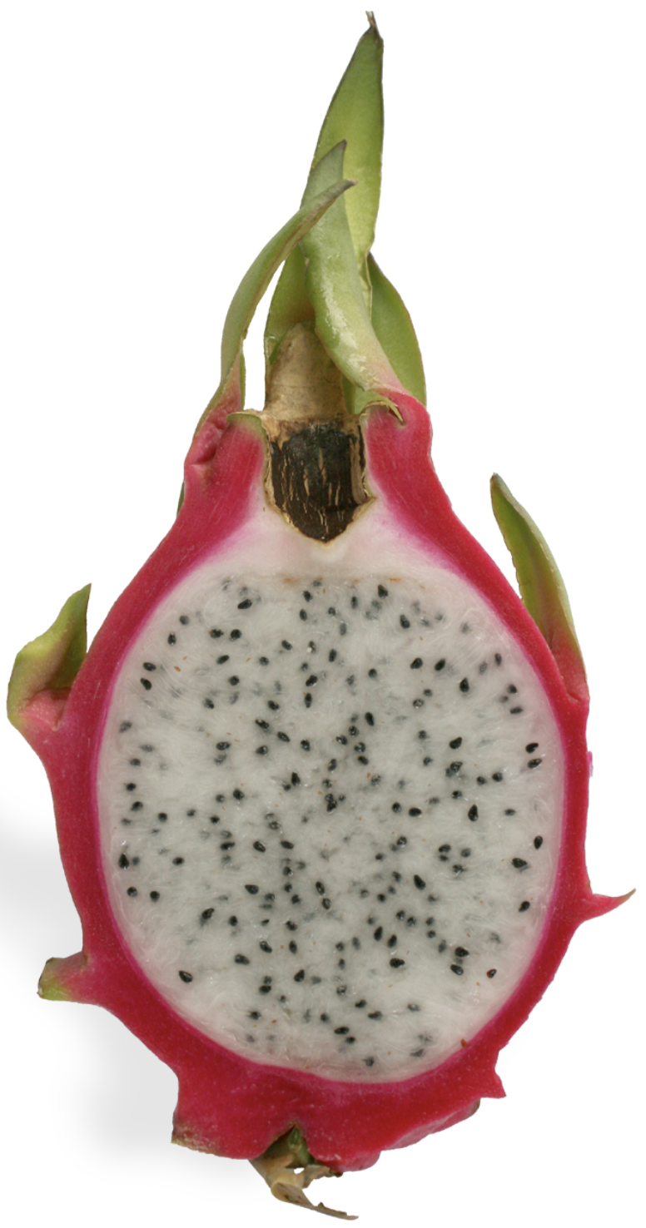
Collaborative Filtering
likes
recommend
similar
likes
likes

Slide 10
Hybrid Filtering
likes
recommend
similar
likes
similar
similar
likes
likes

Slide 11
How to Measure Similarity?
A and B are similar
if A.x = B.x and …
Rules
Decision trees
Euclidean distance
Cosine similarity
Notes:
Numerous domain-specific heuristics and mathematical similarity measures

Slide 12
Other Considerations
Limiting the number of recommendations
Ordering recommendations
Sampling recommendations
Remembering past recommendations
Evaluating recommendations

Slide 13
Agenda
Recommendation System Basics
DSE Graph and Recommendations
Overview of the KillrVideo Graph
Similarity Measures in Gremlin
Demo of Recommender Traversals

Slide 14
DataStax Enterprise Graph
Real-time
Analytics-ready
TinkerPop™-enabled
Graph Database Management System
Efficient
Scalable
Cloud
Applications
Distributed
Secure
Always On

Slide 15
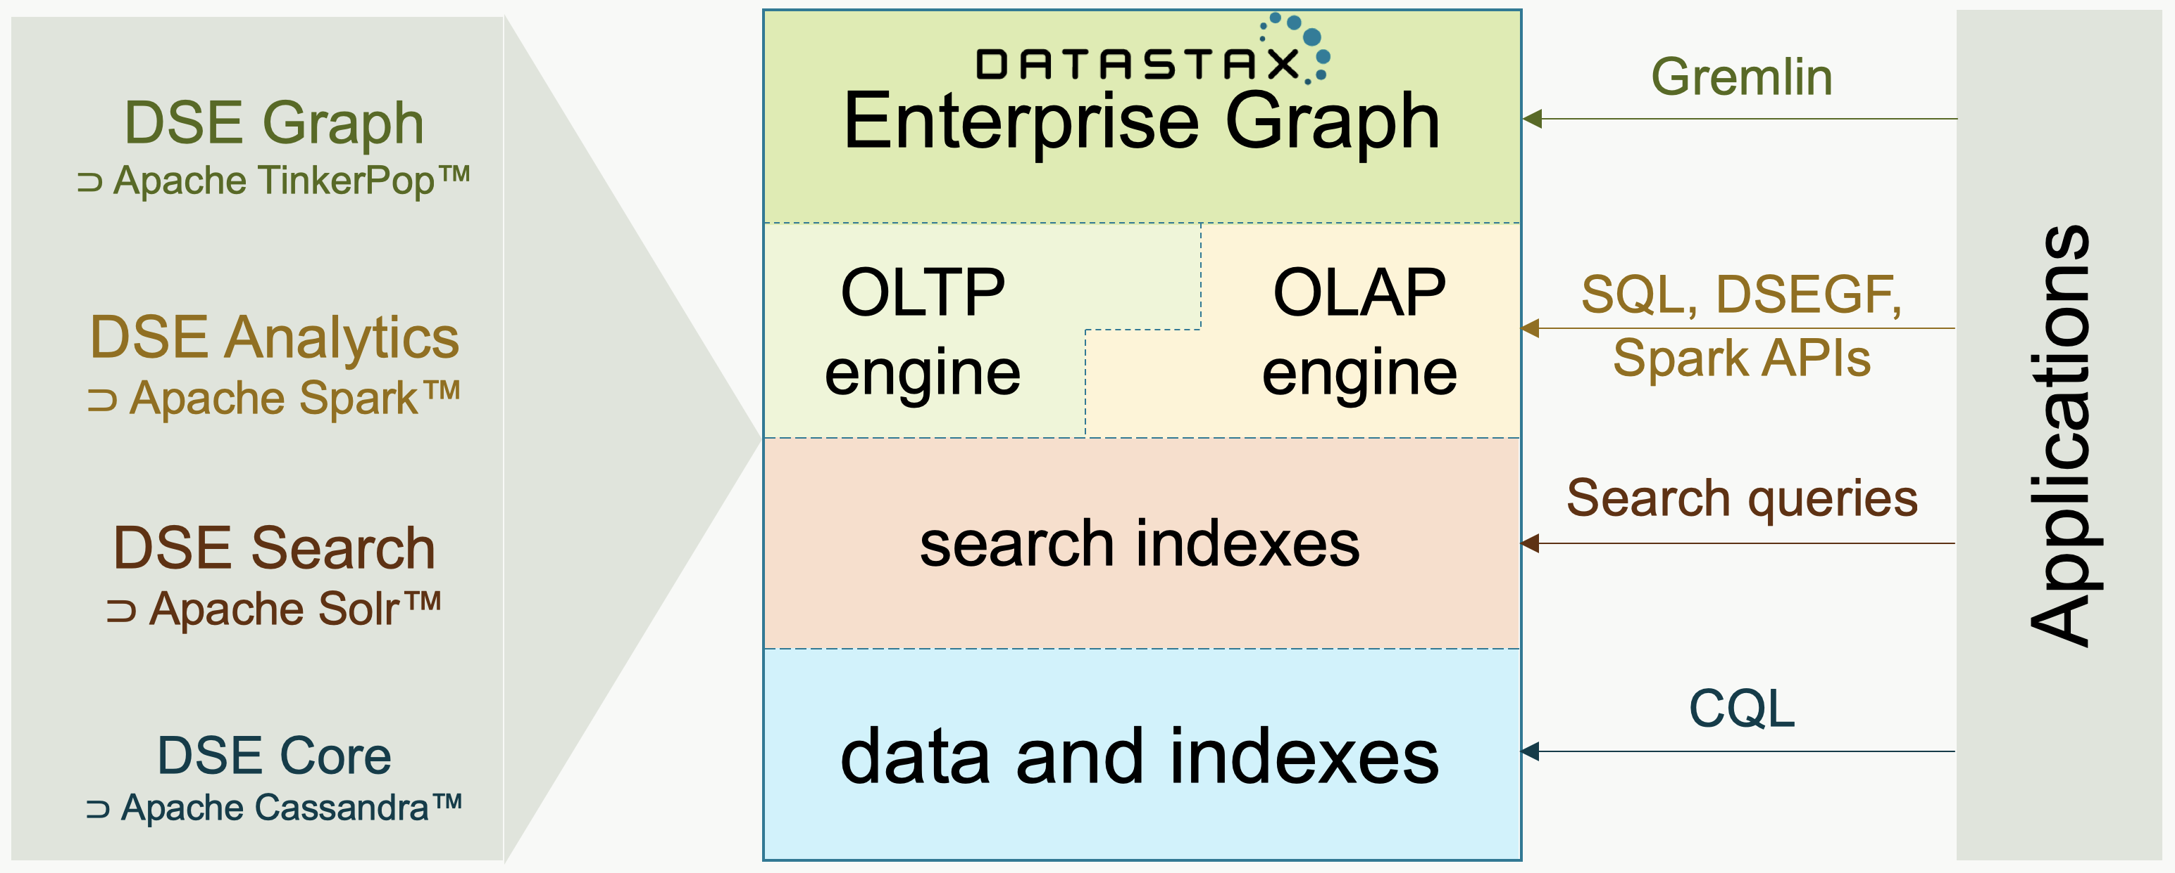
DataStax Enterprise Graph

Slide 16
DSE Graph and Recommendations
Recommendation System Requirements | DSE Graph
Capturing relationships | ✅ Graph
Traversing relationships | ✅ Gremlin
Real-time analysis | ✅ OLTP engine
Offline analysis | ✅ OLAP engine
Complex computations | ✅ Gremlin and other APIs
Performance | ✅ High
Scalability | ✅ High
Availability | ✅ Always on
Security | ✅ Enterprise
Cloud | ✅ Multi, hybrid

Slide 17
Recommendation System + DSE Graph Example Design 1
Users
OLTP traversals
Predictive
Model
Recommendation
Service
DSE Graph
recommendations

Slide 18
Recommendation System + DSE Graph Example Design 2
Predictive
Model
OLAP traversals
DSEGF
Spark jobs
pre-computed
recommendations
Users
OLTP traversals
Recommendation
Service
DSE Graph
recommendations

Slide 19
Recommendation System + DSE Graph Example Design 3
Predictive
Model 2
OLAP traversals
DSEGF
Spark jobs
pre-computed
recommendations
Users
OLTP traversals
Predictive
Model 1
Recommendation
Service
DSE Graph
recommendations

Slide 20
Agenda
Recommendation System Basics
DSE Graph and Recommendations
Overview of the KillrVideo Graph
Similarity Measures in Gremlin
Demo of Recommender Traversals

Slide 21
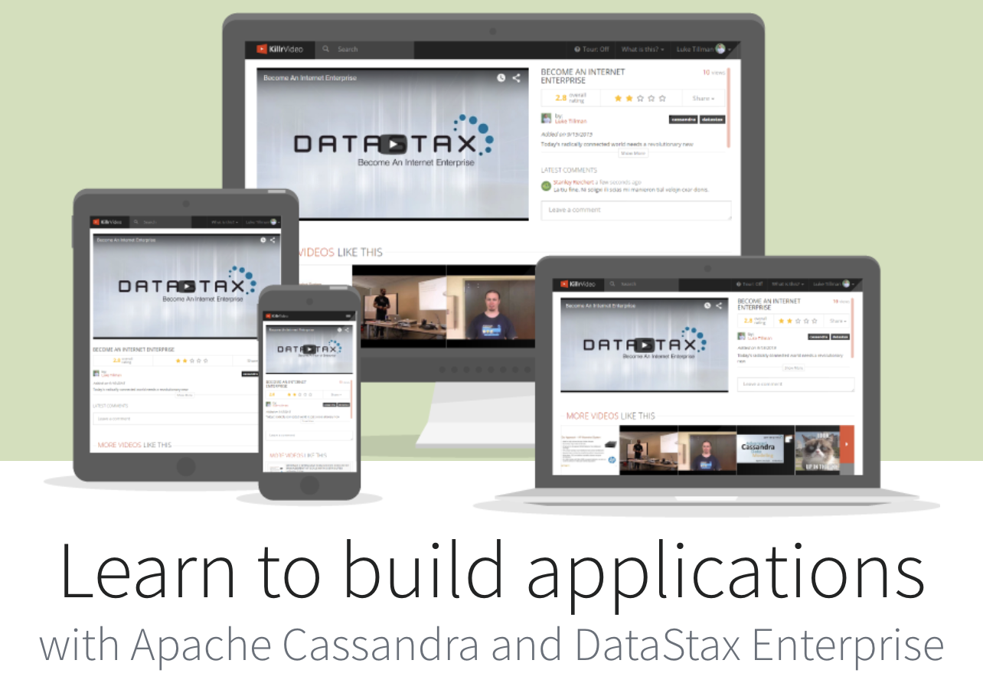
KillrVideo Reference Application
killrvideo.github.io

Slide 22
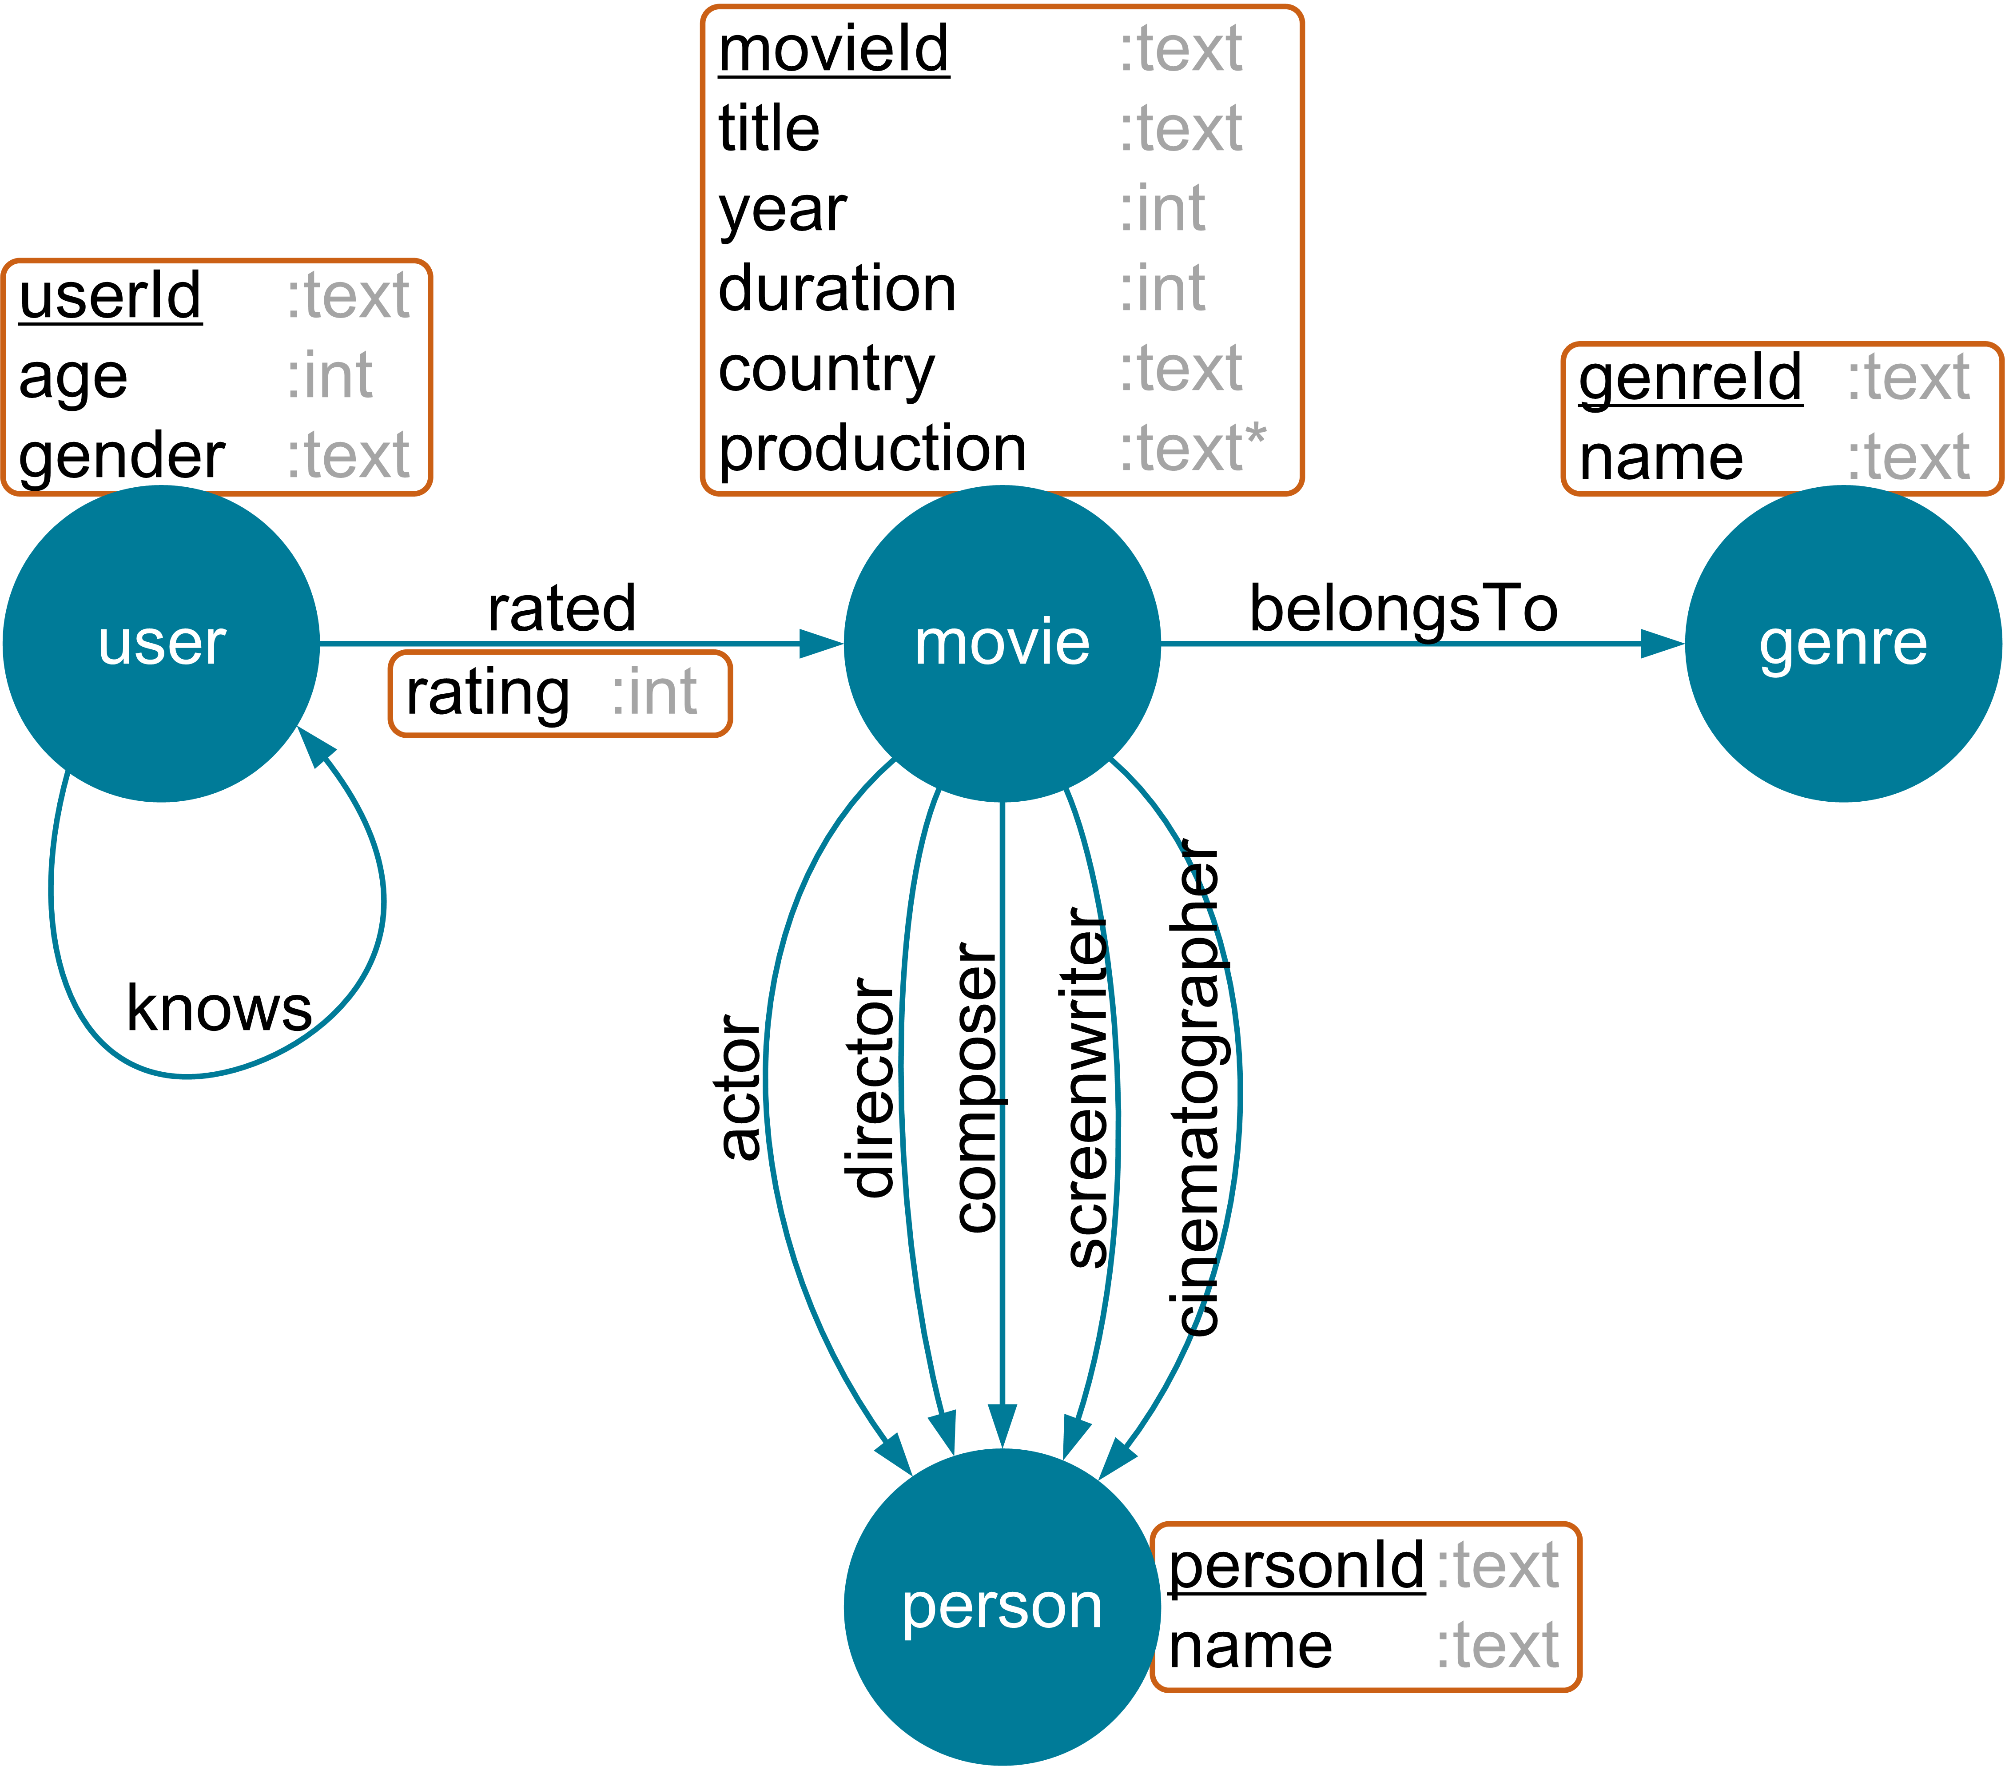
KillrVideo Graph Schema

Slide 23
KillrVideo Graph
Vertex Label | Count
movie | 920
person | 8759
genre | 18
user | 1100
Edge Label | Count
knows | 3500
belongsTo | 2045
cinematographer | 961
composer | 1047
director | 1061
screenwriter | 1668
actor | 10678
rated | 48094

Slide 24
Graphs are About Relationships – Let’s Visualize Them!
DataStax Studio (this presentation)
KeyLines
Linkurious

Slide 25
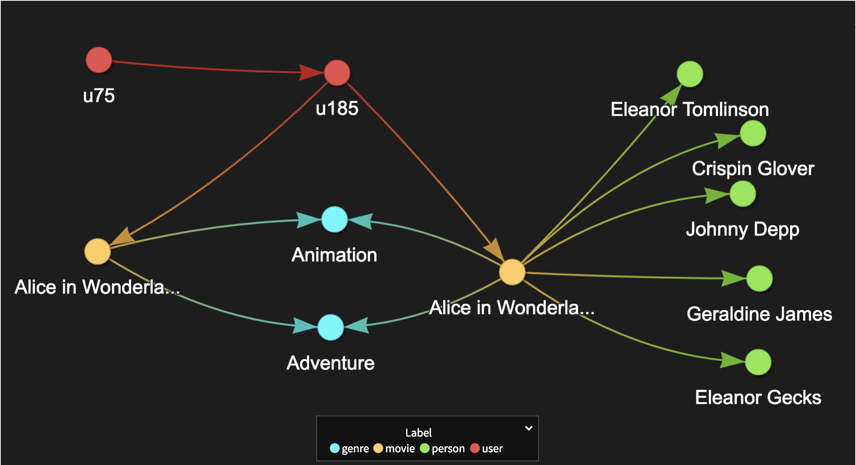
Small Subgraph

Slide 26
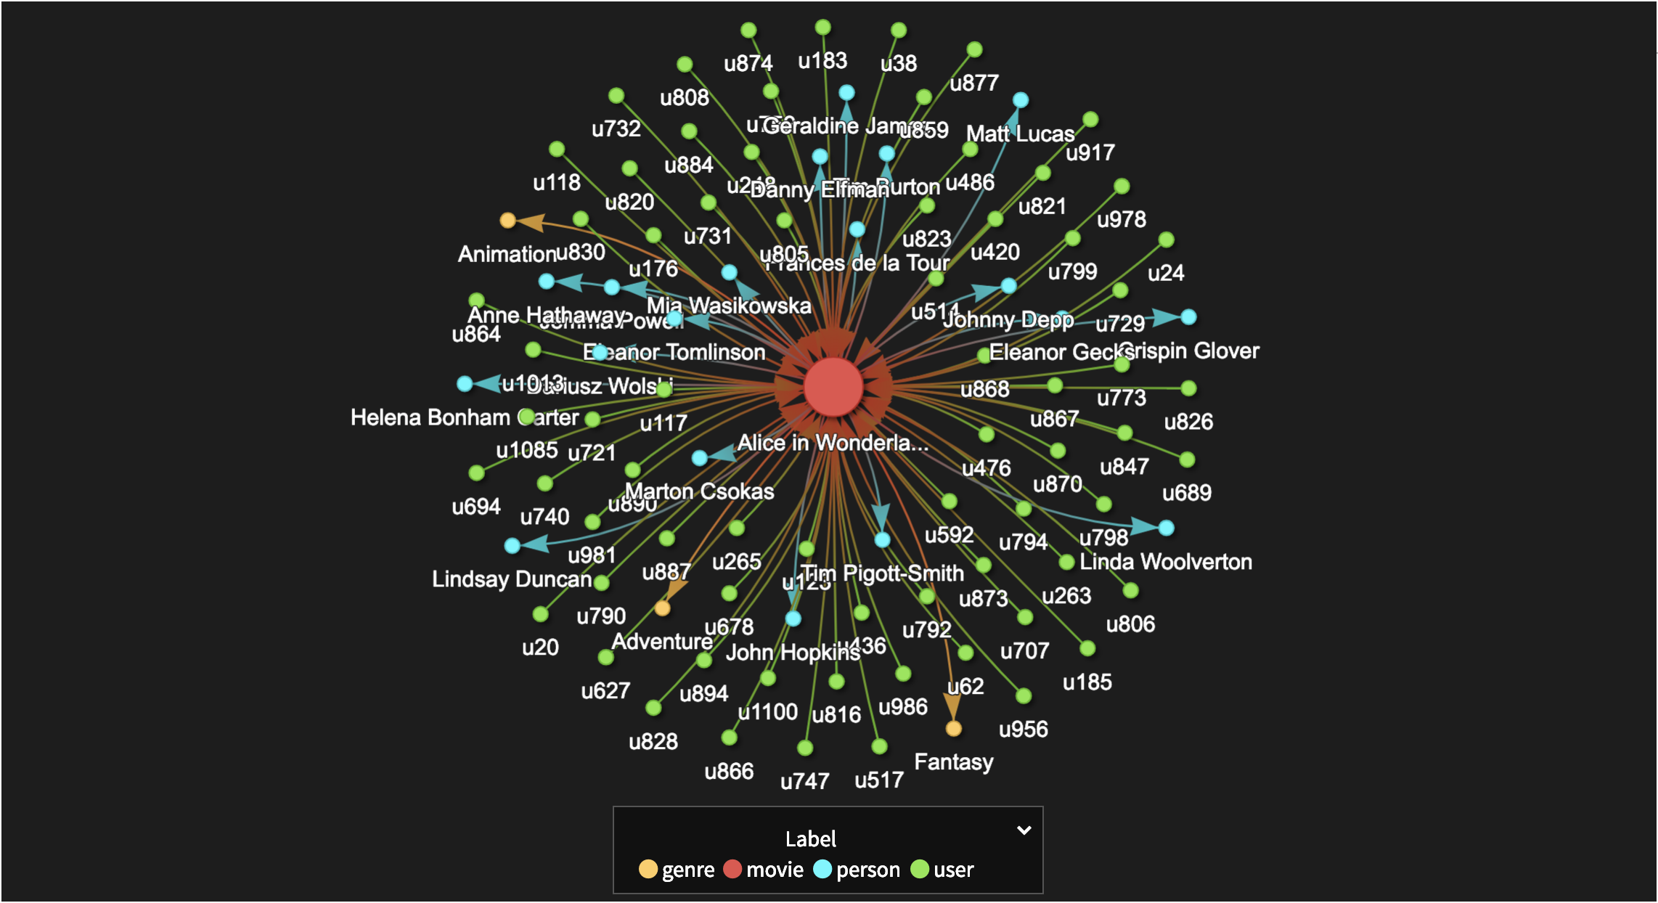
Single Movie Neighborhood

Slide 27
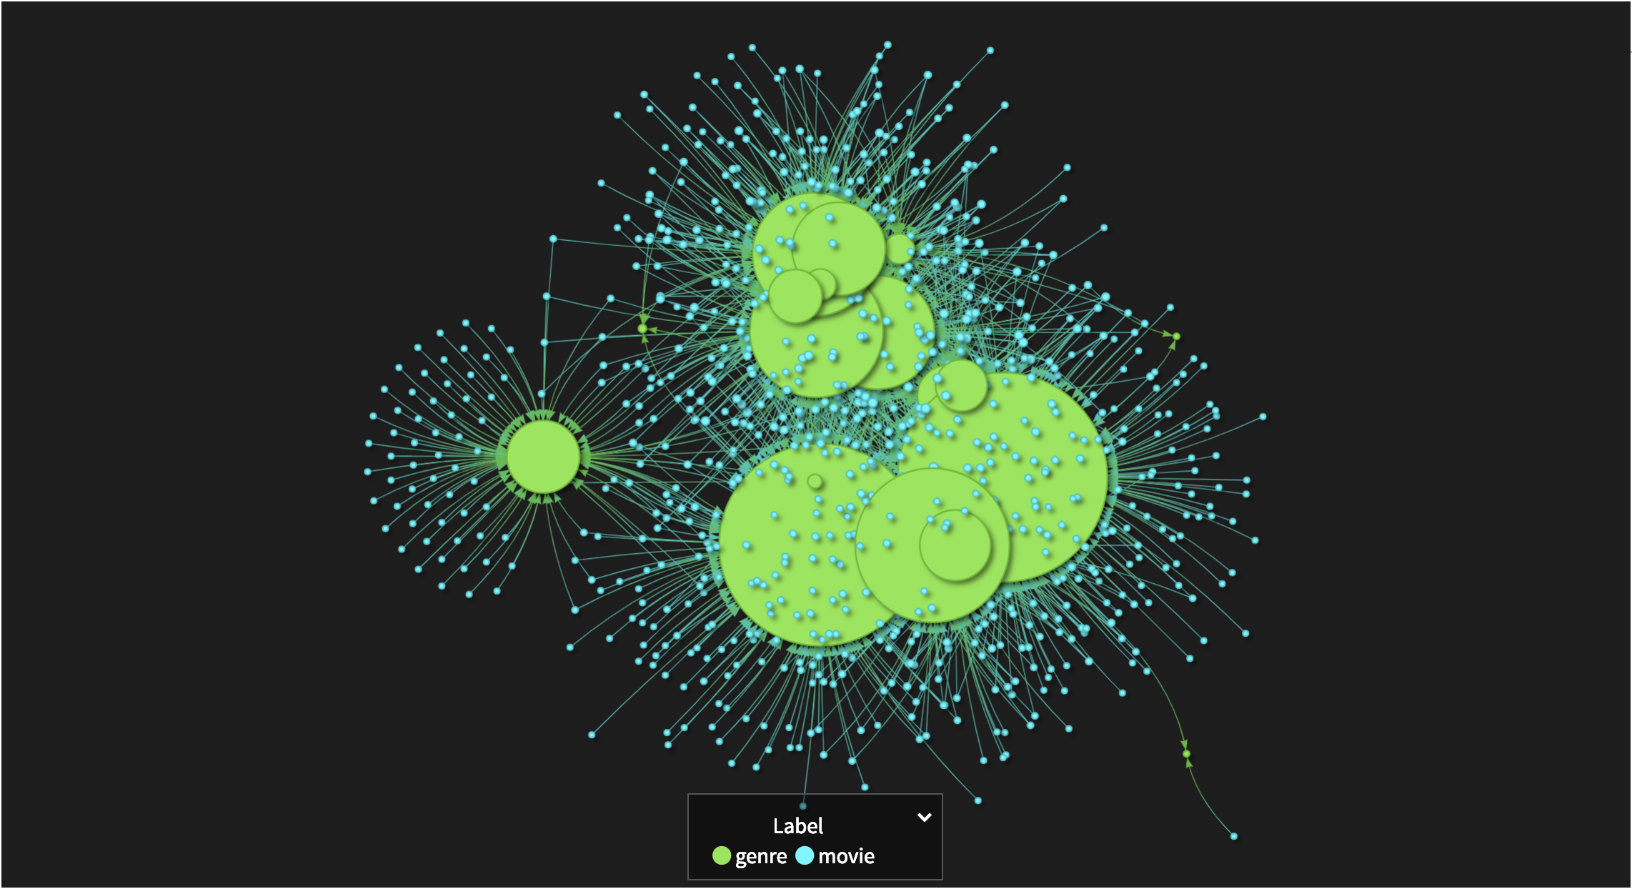
Movies and Genres

Slide 28
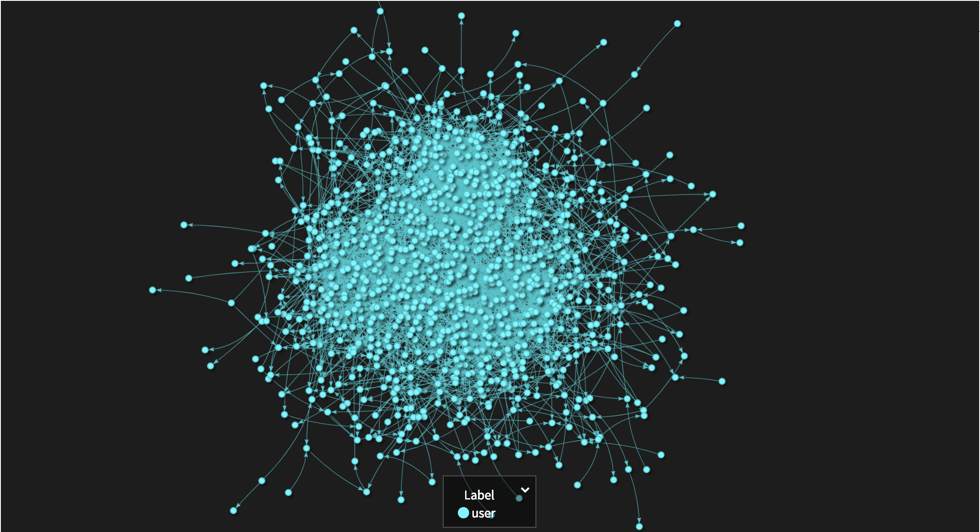
User Network

Slide 29
Agenda
Recommendation System Basics
DSE Graph and Recommendations
Overview of the KillrVideo Graph
Similarity Measures in Gremlin
Demo of Recommender Traversals

Slide 30
Similar Users and Similar Movies
similar
similar

Slide 31
Two Users Are Similar If …
They know each other
They have at least X friends in common
They like the same movie
They have at least X favorite movies in common
They know each other and have at least X favorite movies in common
…
Notes:
How many similar users for a given user will we find for each similarity measure?
Another one to consider: They know each other and are similar in terms of their ages, genders and how they rate movies

Slide 32
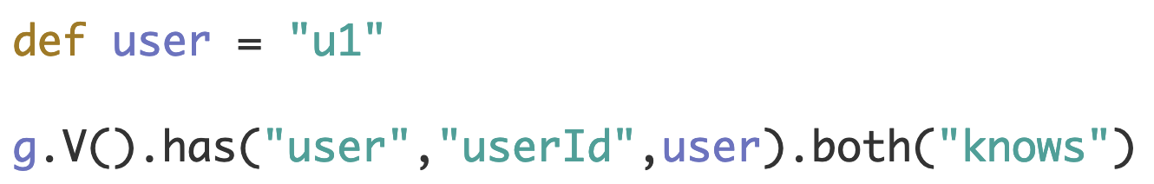
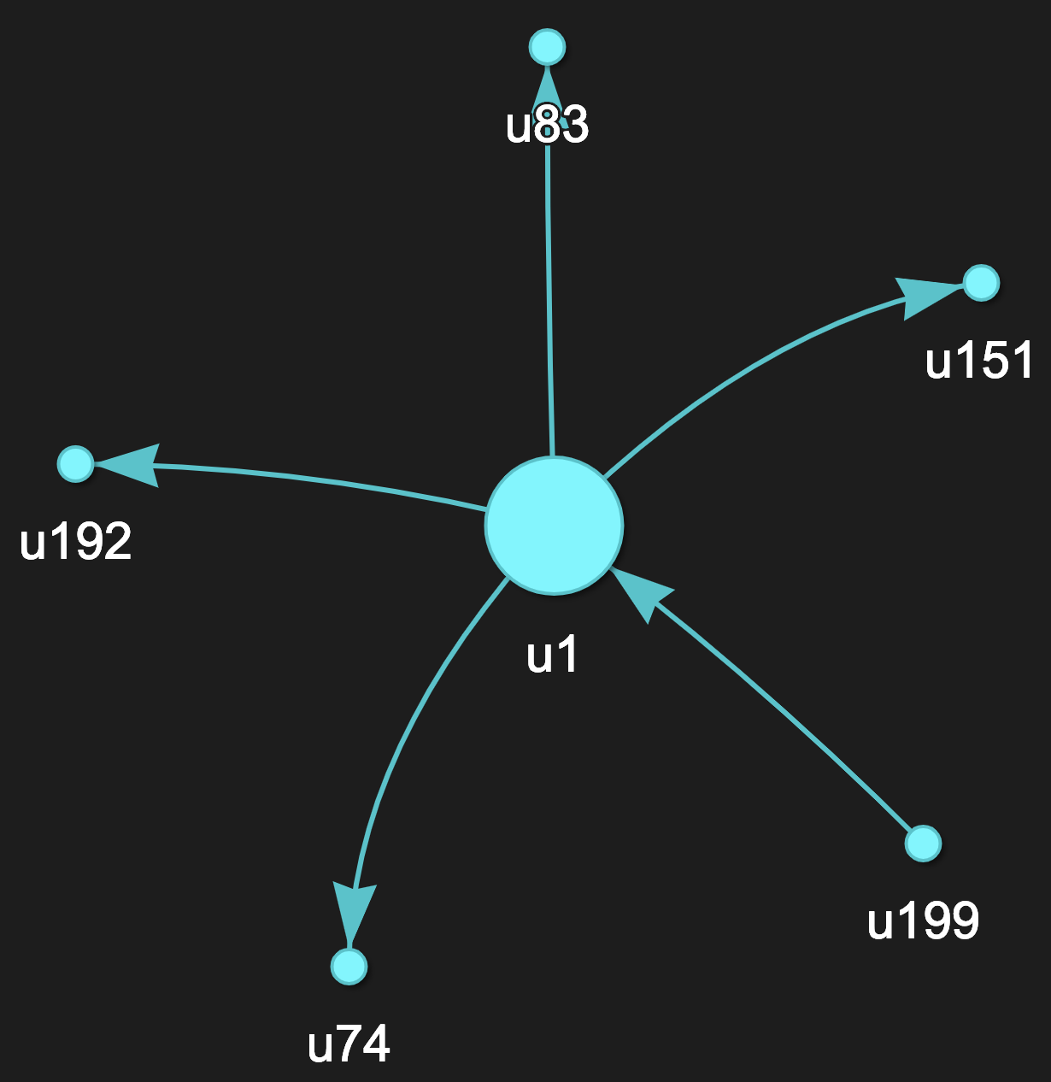
M1: Users know each other
Notes:
def user = "u1"
g.V().has("user","userId",user).both("knows")

Slide 33
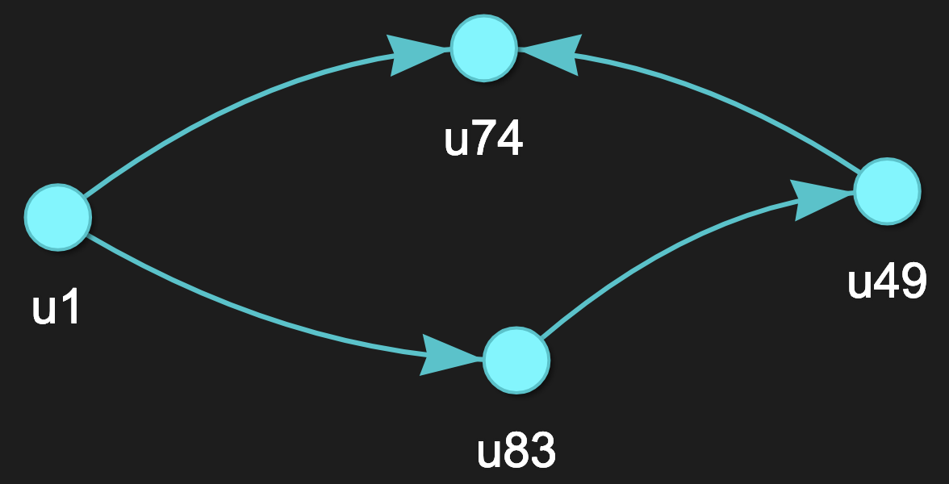
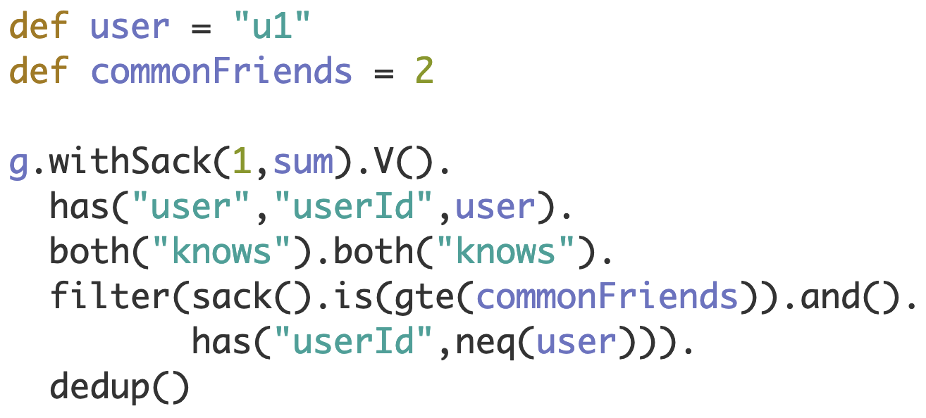
M2: Users have at least X friends in common
Notes:
def user = "u1"
def commonFriends = 2
g.withSack(1,sum).V().
has("user","userId",user).
both("knows").both("knows").
filter(sack().is(gte(commonFriends)).and().
has("userId",neq(user))).
dedup()

Slide 34
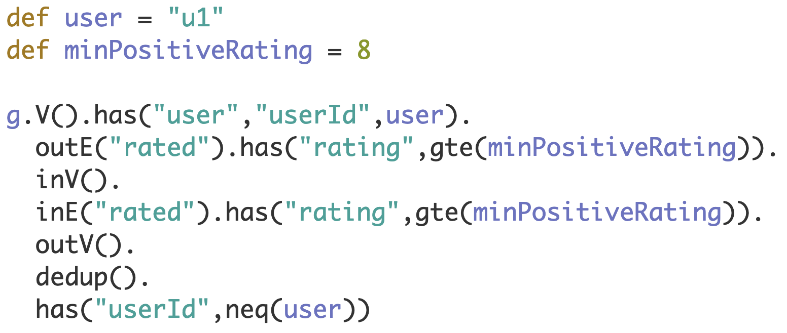
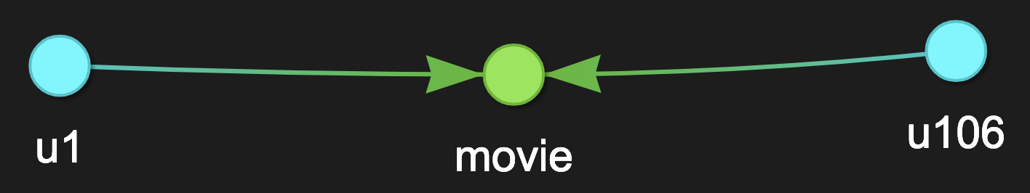
M3: Users like the same movie
Notes:
def user = "u1"
def minPositiveRating = 8
g.V().has("user","userId",user).
outE("rated").has("rating",gte(minPositiveRating)).
inV().
inE("rated").has("rating",gte(minPositiveRating)).
outV().
dedup().
has("userId",neq(user))

Slide 35
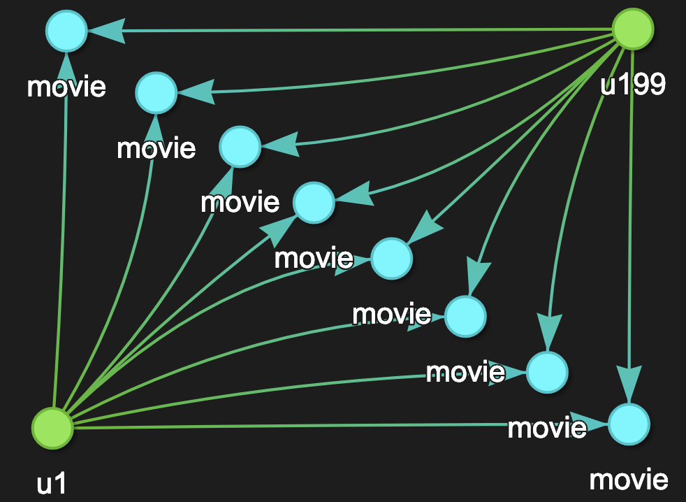
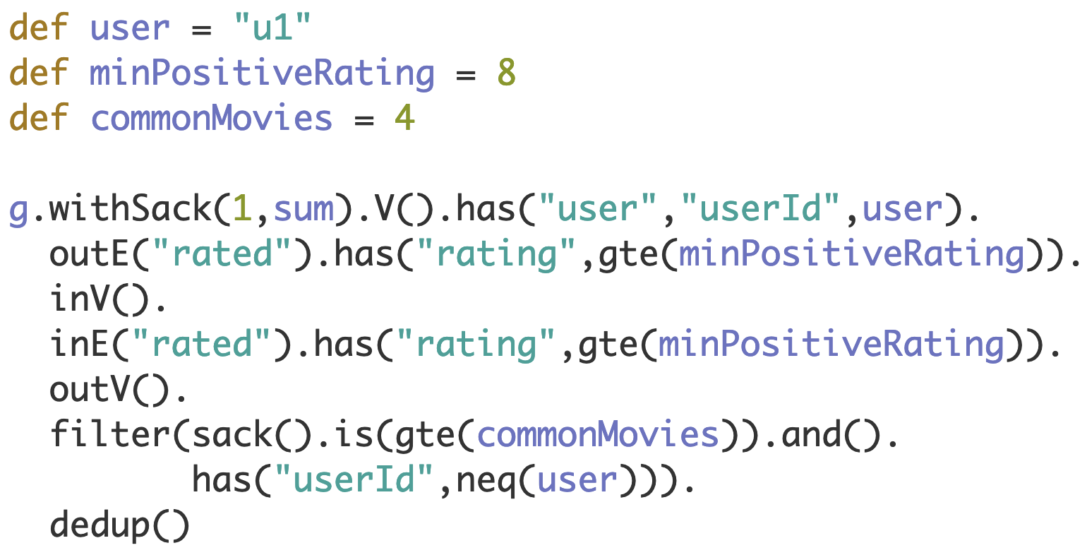
M4: Users have at least X favorite movies in common
Notes:
def user = "u1"
def minPositiveRating = 8
def commonMovies = 4
g.withSack(1,sum).V().has("user","userId",user).
outE("rated").has("rating",gte(minPositiveRating)).
inV().
inE("rated").has("rating",gte(minPositiveRating)).
outV().
filter(sack().is(gte(commonMovies)).and().
has("userId",neq(user))).
dedup()

Slide 36
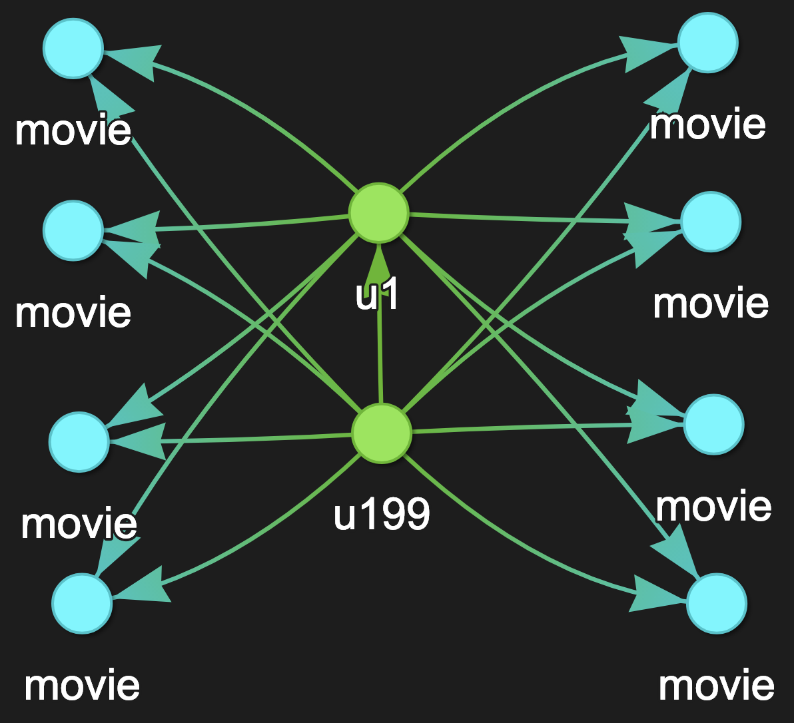
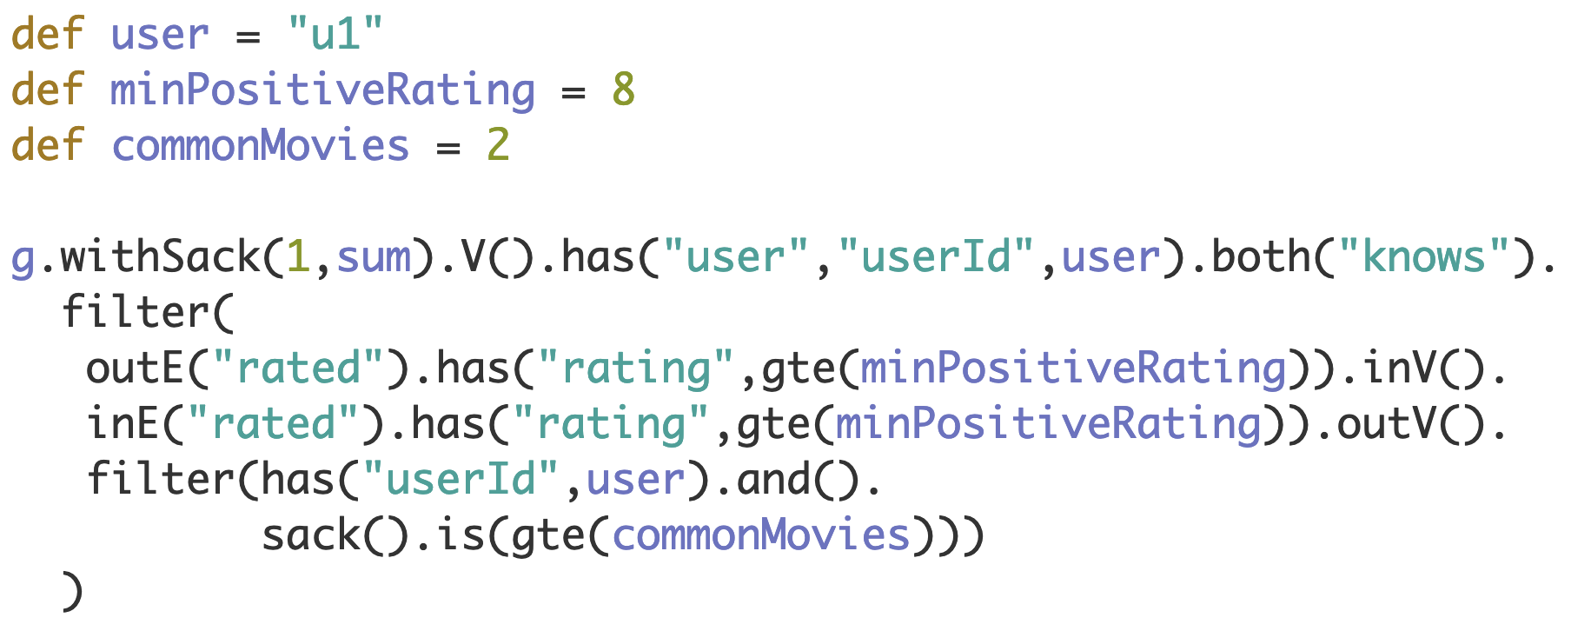
M5: Users know each other and have at least X favorite movies in common
Notes:
def user = "u1"
def minPositiveRating = 8
def commonMovies = 2
g.withSack(1,sum).V().has("user","userId",user).both("knows").
filter(
outE("rated").has("rating",gte(minPositiveRating)).inV().
inE("rated").has("rating",gte(minPositiveRating)).outV().
filter(has("userId",user).and().
sack().is(gte(commonMovies)))
)

Slide 37
Two Movies Are Similar If …
They belong to the same genre
They belong to the same genre and have similar features like year and average rating
…
Notes:
How many similar users for a given user will we find for each similarity measure?

Slide 38
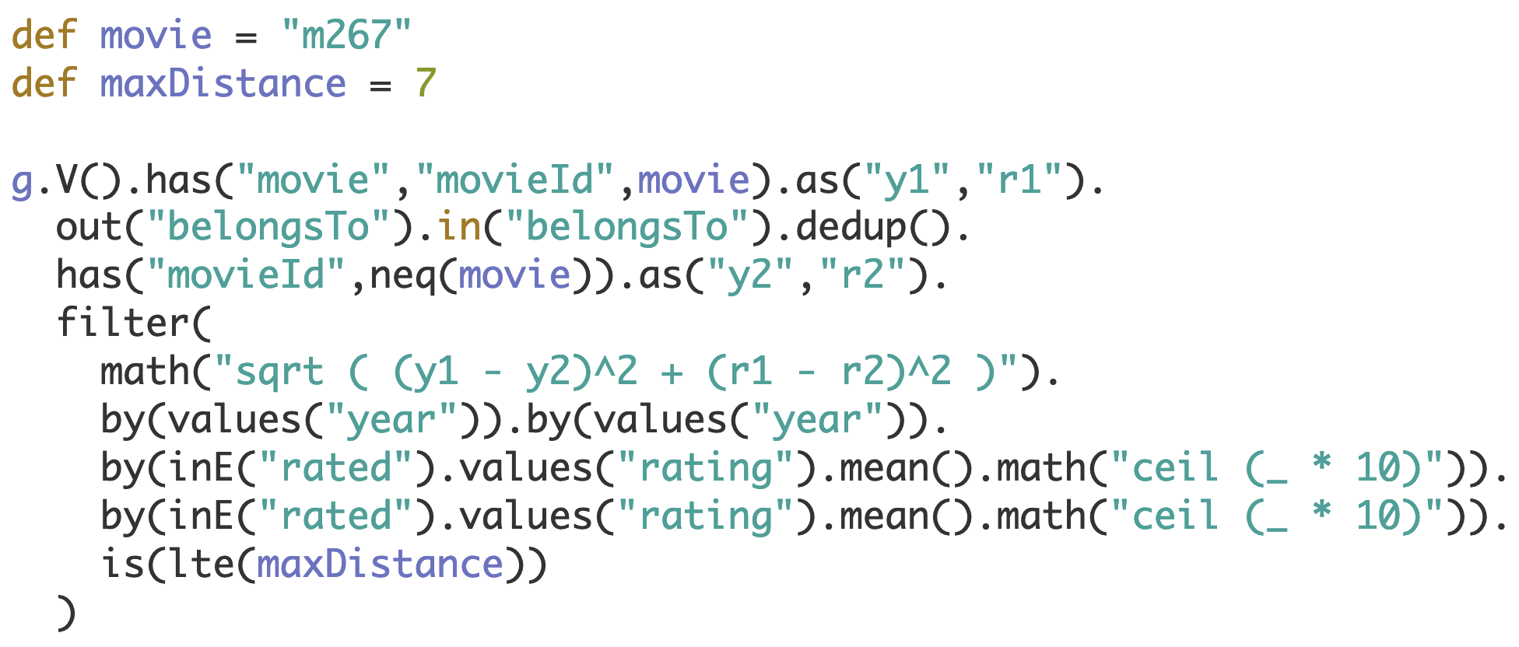
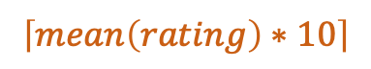

M6: Movies belong to the same genre and have similar features (year and avg rating)
2010
$$year$$
2007
82
85
$$\left\lceil mean\left(rating\right)∗10\right\rceil$$
Notes:
def movie = "m267"
def maxDistance = 7
g.V().has("movie","movieId",movie).as("y1","r1").
out("belongsTo").in("belongsTo").dedup().
has("movieId",neq(movie)).as("y2","r2").
filter(
math("sqrt ( (y1 - y2)^2 + (r1 - r2)^2 )").
by(values("year")).by(values("year")).
by(inE("rated").values("rating").mean().math("ceil (_ * 10)")).
by(inE("rated").values("rating").mean().math("ceil (_ * 10)")).
is(lte(maxDistance))
)

Slide 39
Which Similarity Measure to Choose?
Different classes of recommendations
Recommendations based on user histories, recommendations based on trending movies, …
Different classes of users
New users, active users, users who do not rate movies, …
Finding optimal parameters is hard
minPositiveRating, maxDistance, commonMovies, commonFriends, …
Evaluation is hard
Training datasets, user studies, responses to recommendations from real users

Slide 40
Agenda
Recommendation System Basics
DSE Graph and Recommendations
Overview of the KillrVideo Graph
Similarity Measures in Gremlin
Demo of Recommender Traversals

Slide 41
Conclusions
DSE Graph is an excellent choice for Recommendations
Choosing “good” similarity measures is the key
Recommender traversals expressed in Gremlin are efficient and concise

Slide 42
Want to Learn More?
academy.datastax.com
Free DSE Graph and Gremlin courses on DataStax Academy
Recommender Traversals with Bob Briody
Developer Blog
When Rotten Tomatoes Isn't Enough: Twitter Sentiment Analysis with DSE by Amanda Moran
Distributed Data Show
Episode 25: Adding a Graph-Based Recommender to KillrVideo with David Gilardi
Twitch
Graph recommendation engine in Python with Jeff Carpenter & David Gilardi

Slide 43
Download Demo: bit.ly/rec-sys
achebotko@datastax.com

